Slide 1
The effects of climate changes on agriculture in the Algarve

Slide 2
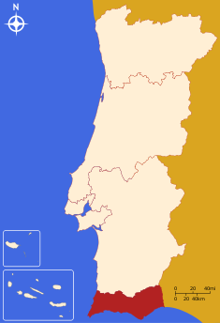
Geographical Position
The Algarve is located in the south of Portugal on the south-western extreme of the Iberian Peninsula.
Natural Frontiers
Mountain range
Spain
Atlantic Ocean
Algarve Location

Slide 3
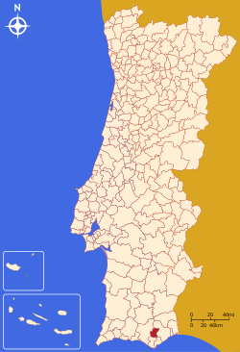
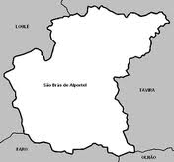
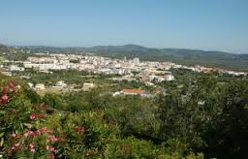
São Brás de Alportel location
São Brás de Alportel is a town located in the Algarve, between the mountains and the sea. It´s about16Km away from the district capital – FARO.
Population
11000 inhabitants

Slide 4
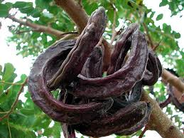
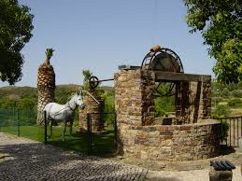
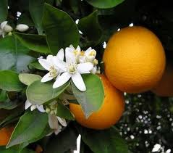
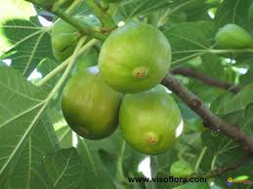
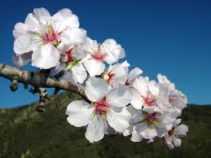
São Brás and the Arabian Culture
Arabian influence
Farming practices and techniques
Water devices – Water-mills
Orchards – Citrus, carob tree , almond-tree and fig-tree

Slide 5
CLIMATE

Slide 6
Temperate- Mediterranean;
Balmy temperatures all year-round;
CLIMATE
Longer dry periods than the rest of the country;
Less frequent and less intense rainfalls.
Winters tend to be mild and humid and summers are long, hot and dry.

Slide 7
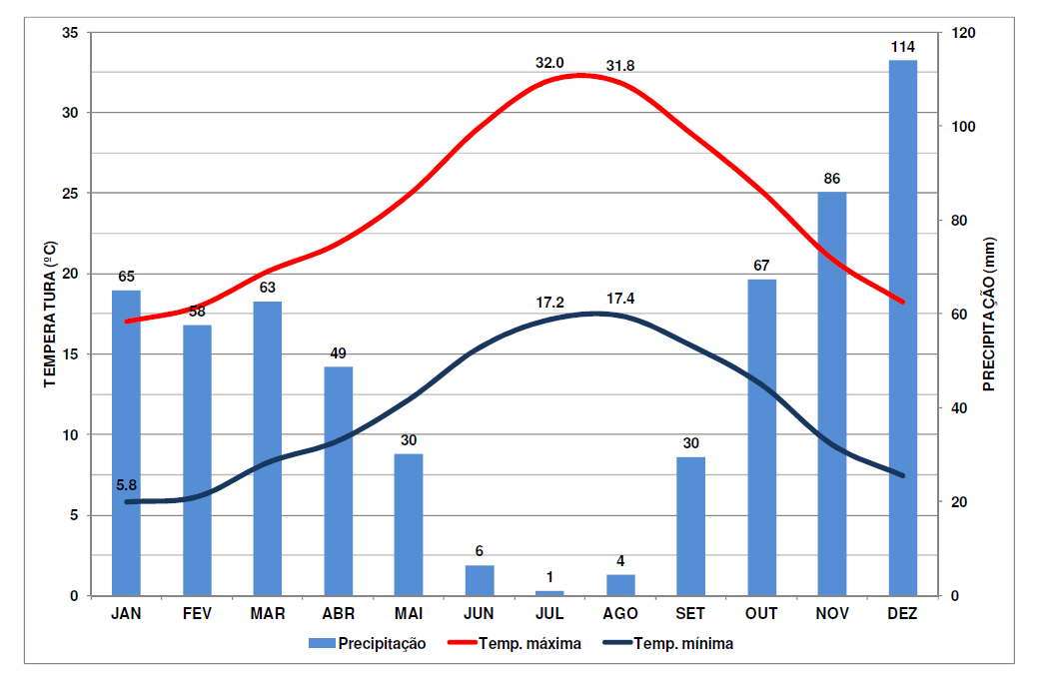
Precipitation and Temperature
Precipitation:
Irregular;
Average annual temperature :
Between 15 ºC and 17ºC;
minimum values in January and maximum values in August.

Slide 8
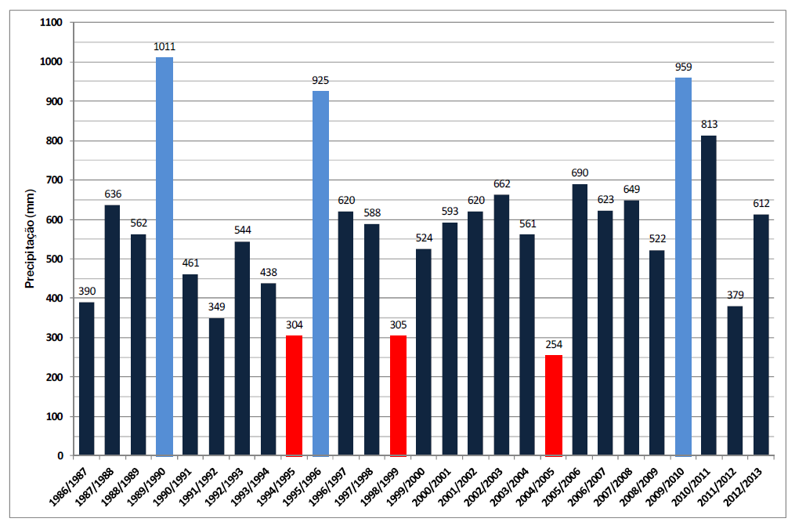
The average rainfall (until 2013): constant;
Greater regularity of extreme situations;
Short periods of intensive precipitation followed by longer ones without precipitation.

Slide 9
Rise of the average temperaure in 0,37ºC
Climate changes in the Algarve
8 out of the 10 hottest summers occurred after 1990
Decrease of the thermal amplitude
Autumn precipitation - below the average in 11 out of the last 20 years
Decrease of the spring rainfalls

Slide 10
AGRICULTURE

Slide 11
Agriculture
Wide diversity of microclimates and soils
Concentrated in a small area (around 540.000 acres).

Slide 12
Climate changes and their influence on agriculture
In the past
Currently
Dry crops
Carob tree
Fig-tree
Almond tree
Olive tree
Irrigated crops
(the same trees)
Due to
Seasons’ inconstancy – shorter rainy periods;
Economic competitiveness.
Citrus trees

Slide 13
Conclusion
Water availabilty and watering capability;
Soil fertility;
Erosion and fires;
Crop diseases;
Aging population.
Increasingly unfavourable conditions for agriculture;
precipitation reduction;
temperature rise;
More frequent and extreme weather phenomena;
Droughts - Increase of desertification.
Future scenarios
Critical factors

Slide 14
Our agriculture and forests have been seriously affected by the climate changes that have been occuring in the last few decades.
Until the end of the century these conditions are expected to get worse unless there’s a dramatic change in people’s habits.

